Slide 1

Project 4
Machine Learning models using Digital Marketing data
By: Aaqib Jabbar , Sofia Pai , Prachi Patel ,Richard Encarnacion

Slide 2

Project Ideation
Analyze and predict customer conversion in digital marketing
The dataset provides an extensive view of customer interaction with digital marketing campaigns.
This dataset includes customer demographic, marketing-specific metrics, customer engagement indicators, and purchase data history.

Slide 3

Data Fetching
Rabie El Kharoua. (2024). 📈 Predict Conversion in Digital Marketing Dataset [Data set]. Kaggle. https://doi.org/10.34740/KAGGLE/DSV/8742946
Attribution 4.0 International (CC BY 4.0)

Slide 4

Dataset: Demographic Information
CustomerID: Unique identifier for each customer.
Age: Age of the customer.
Gender: Gender of the customer (Male/Female).
Income: Annual income of the customer in USD.

Slide 5

Dataset: Marketing-specific Variables
CampaignChannel: The channel through which the marketing campaign is delivered (Email, Social Media, SEO, PPC, Referral).
CampaignType: Type of the marketing campaign (Awareness, Consideration, Conversion, Retention).
AdSpend: Amount spent on the marketing campaign in USD.
ClickThroughRate: Rate at which customers click on the marketing content.
ConversionRate: Rate at which clicks convert to desired actions (e.g., purchases).
AdvertisingPlatform: Confidential.
AdvertisingTool: Confidential.

Slide 6

Dataset: Customer Engagement Variables
WebsiteVisits: Number of visits to the website.
PagesPerVisit: Average number of pages visited per session.
TimeOnSite: Average time spent on the website per visit (in minutes).
SocialShares: Number of times the marketing content was shared on social media.
EmailOpens: Number of times marketing emails were opened.
EmailClicks: Number of times links in marketing emails were clicked.

Slide 7
Historical Data & Target Variable
PreviousPurchases: Number of previous purchases made by the customer.
LoyaltyPoints: Number of loyalty points accumulated by the customer.
Conversion: Binary variable indicating whether the customer converted (1) or not (0).

Slide 8

Data Cleaning
Imports necessary libraries (pandas, numpy, matplotlib, seaborn, sklearn, and tensorflow).
Reads a CSV file (digital_marketing_campaign_dataset.csv) into a DataFrame.
Displays the first few rows (head()).
Checks the shape, summary statistics, missing values, and duplicate records.
Drops unnecessary columns (AdvertisingPlatform and AdvertisingTool due to confidential data).
Saves the cleaned DataFrame to a new CSV file (cleaned_data.csv).

Slide 9

Spark Summary
Key Marketing Metrics Computation:
Conversion Rate Calculation:
Overall conversion rate.
Conversion rate by Campaign Type and Campaign Channel.
Cost per Acquisition (CPA): Calculates cost per customer conversion.
Click-Through Rate (CTR): Measures engagement in marketing campaigns.
Customer Lifetime Value (CLV) (Approximation): Computes average transaction value per customer.

Slide 10

Spark Analysis
The overall conversion rate: 87.649
CTR (Click-Through Rate): 15.482
Avg Transaction Value: 5000.944
Returning Visitors: 7700
Avg Email Opens: 9.476
Avg Email Clicks: 4.467
Repeat Purchase Count: 6368

Slide 11

Machine Learning
Classification
Logistic Regression
Random Forest
Deep Learning
Neural Network

Slide 12
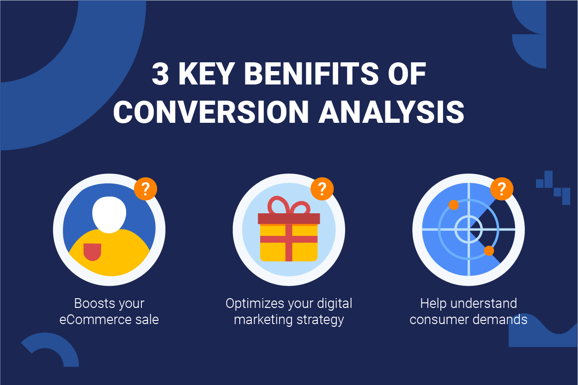
Conversion in Digital Marketing

Slide 13
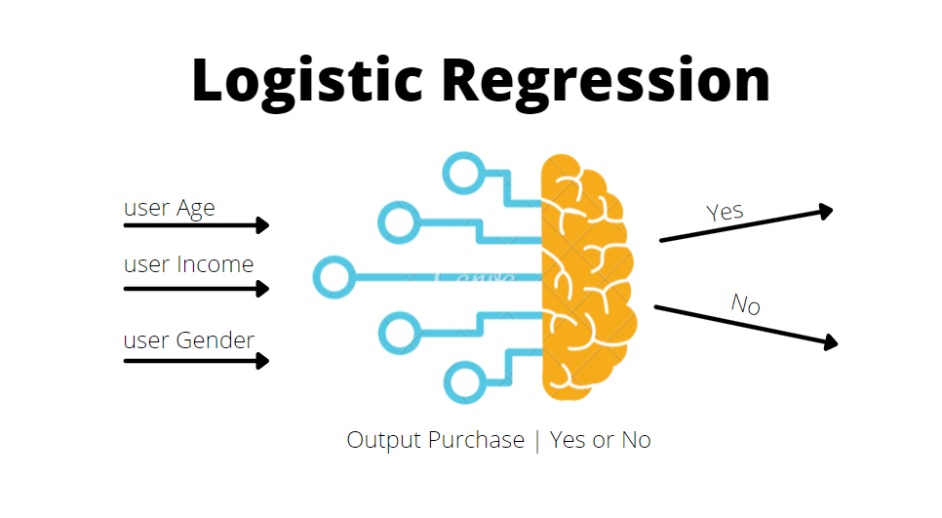
The goal is to predict whether a customer would be classified as active participant as (1) or passive participant as (0).

Slide 14
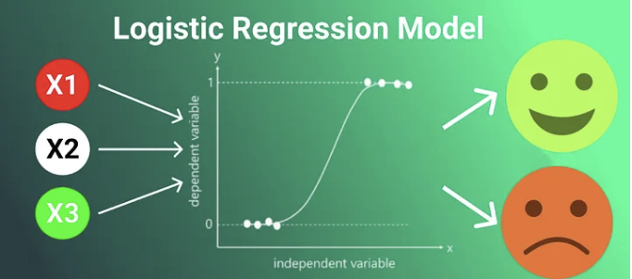
Why Logistic Regression
Widely use in Machine Learning
It's simplicity
Efficiency
Effectiveness in predicting probabilities

Slide 15
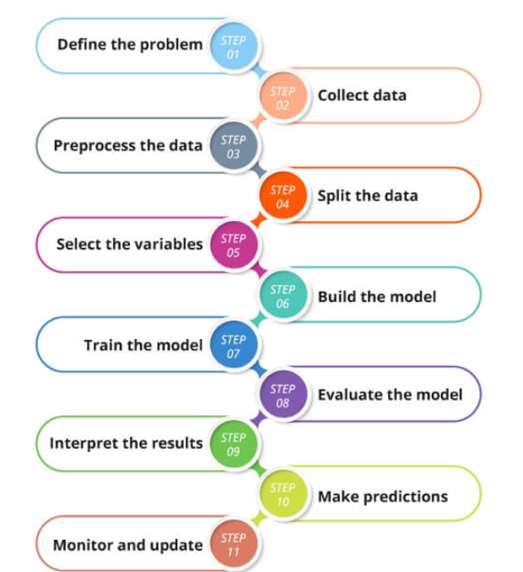
Machine Learning Steps:
The target variable is Conversion.
The features are 'Age', 'Gender', 'Income', 'CampaignChannel', 'CampaignType', 'AdSpend', 'ClickThroughRate', 'ConversionRate', 'WebsiteVisits', 'PagesPerVisit', 'TimeOnSite', 'SocialShares', 'EmailOpens', 'EmailClicks', 'PreviousPurchases', 'LoyaltyPoints'
Splitting the data into training and testing sets.
Training the model.
Evaluating model performance using metrics like precision, recall, F1-score, and a confusion matrix, with a focus on predicting the Conversion.

Slide 16
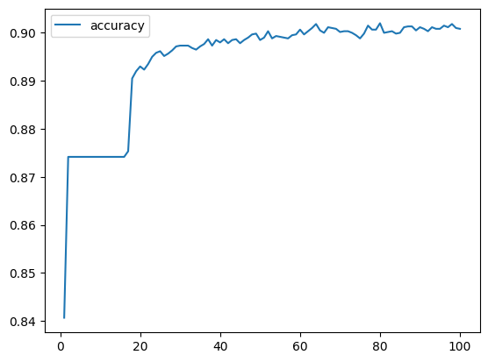
Logistic Regression
Overview of Analysis:
The target variable, Conversion, showed significant imbalance with:
1 7012
0 988
Accuracy: 88%
Precision: 0 -> 0.60, 1 -> 0.88
Recall: 0 -> 0.01, 1 -> 1.00
Conclusion: While the model shows a high overall accuracy, this metric is misleading due to the class imbalance. Precision and recall provide more meaningful insights, revealing that the model is very good at predicting conversions (1) but poor at identifying non-conversions (0).

Slide 17

What is Neural Network
A computational model inspired by the human brain.
Basic structure: Neurons, layers, weights, and biases
neural networks became popular again with advancements in technology.

Slide 18

Components of Neural Networks
Neurons:
nodes/neurons in each layer.
Activation functions: Sigmoid, ReLU, Tanh.
Layers:
Input Layer, Hidden Layers, Output Layer.
each layer transforms the input data.
Weights and Biases:
The role of weights and biases in the learning process.
Backpropagation and gradient descent.
Notes:
Our neural network has two inp
We randomly split the data into training and test datasets using scikit-learn's train_test_split method.
Normalized both datasets using scikit-learn's StandardScaler class.
Using the Keras module, created a basic neural network with two neurons in the hidden layer.
Trained the neural network model with 100 epochs.
Evaluated the performance of our model by printing our test loss metric and determined the predictive accuracy of the model on the test dataset.
Additionally created a new neural network with a different number of neurons.
Trained the new neural network model on the same training data and tested the performance on the same testing dataset.
uts to produce one classification output

Slide 19
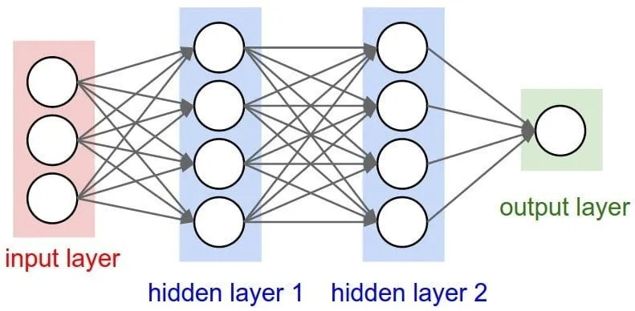
How Neural Networks Work
Feedforward Process:
Input data passing through layers.
How the network produces predictions.
Training the Network:
Training via backpropagation and updating weights.
Loss function
Optimization:
Gradient descent and its variations

Slide 20
Neural Network Analysis:
Attempt 1:
layer1 = 8 -> relu
hidden_layer = 5 -> sigmoid
Output Layer -> sigmoid
accuracy: 0.89 - loss: 0.3043
Attempt 2:
layer1 = 30 -> relu
Second hidden_nodes_layer2 = 20 -> sigmoid
Third hidden_nodes_layer3 = 17 -> sigmoid
Fourth hidden_nodes_layer4 = 5 -> sigmoid
Output Layer -> sigmoid
accuracy: 0.8540 - loss: 0.8611
Evaluation Metrics:
Accuracy: Measures the proportion of correct predictions. In Attempt 1, an accuracy of 0.89 shows strong performance, indicating that most predictions are correct. In Attempt 2, an accuracy of 0.8540 is still decent but lower than Attempt 1, meaning that the more complex architecture may not have generalized as well to the data.
Loss: Represents how well the model's predictions match the true labels. A lower loss means the model is making more accurate predictions. Attempt 1 has a loss of 0.3043, which is relatively low, suggesting a good fit. Attempt 2, with a loss of 0.8611, has a higher loss, indicating poorer performance and potentially an overfitting issue or that the model is too complex for the task.
Notes:
Conclusion:
The first attempt provides a strong performance with relatively simple architecture. The second attempt, despite being more complex, struggles with overfitting and higher loss.
It's important to find the right balance in model complexity and layer configuration based on the task and the dataset size.

Slide 21

Random Forest Analysis
Strong Prediction Power – Using 500 trees helps our model make accurate predictions.
Better Generalization – The model avoids overfitting by combining multiple trees.
Optimized Data Processing – We scaled the data to improve model performance.
Clear Performance Insights – The confusion matrix helps us see false predictions.

Slide 22
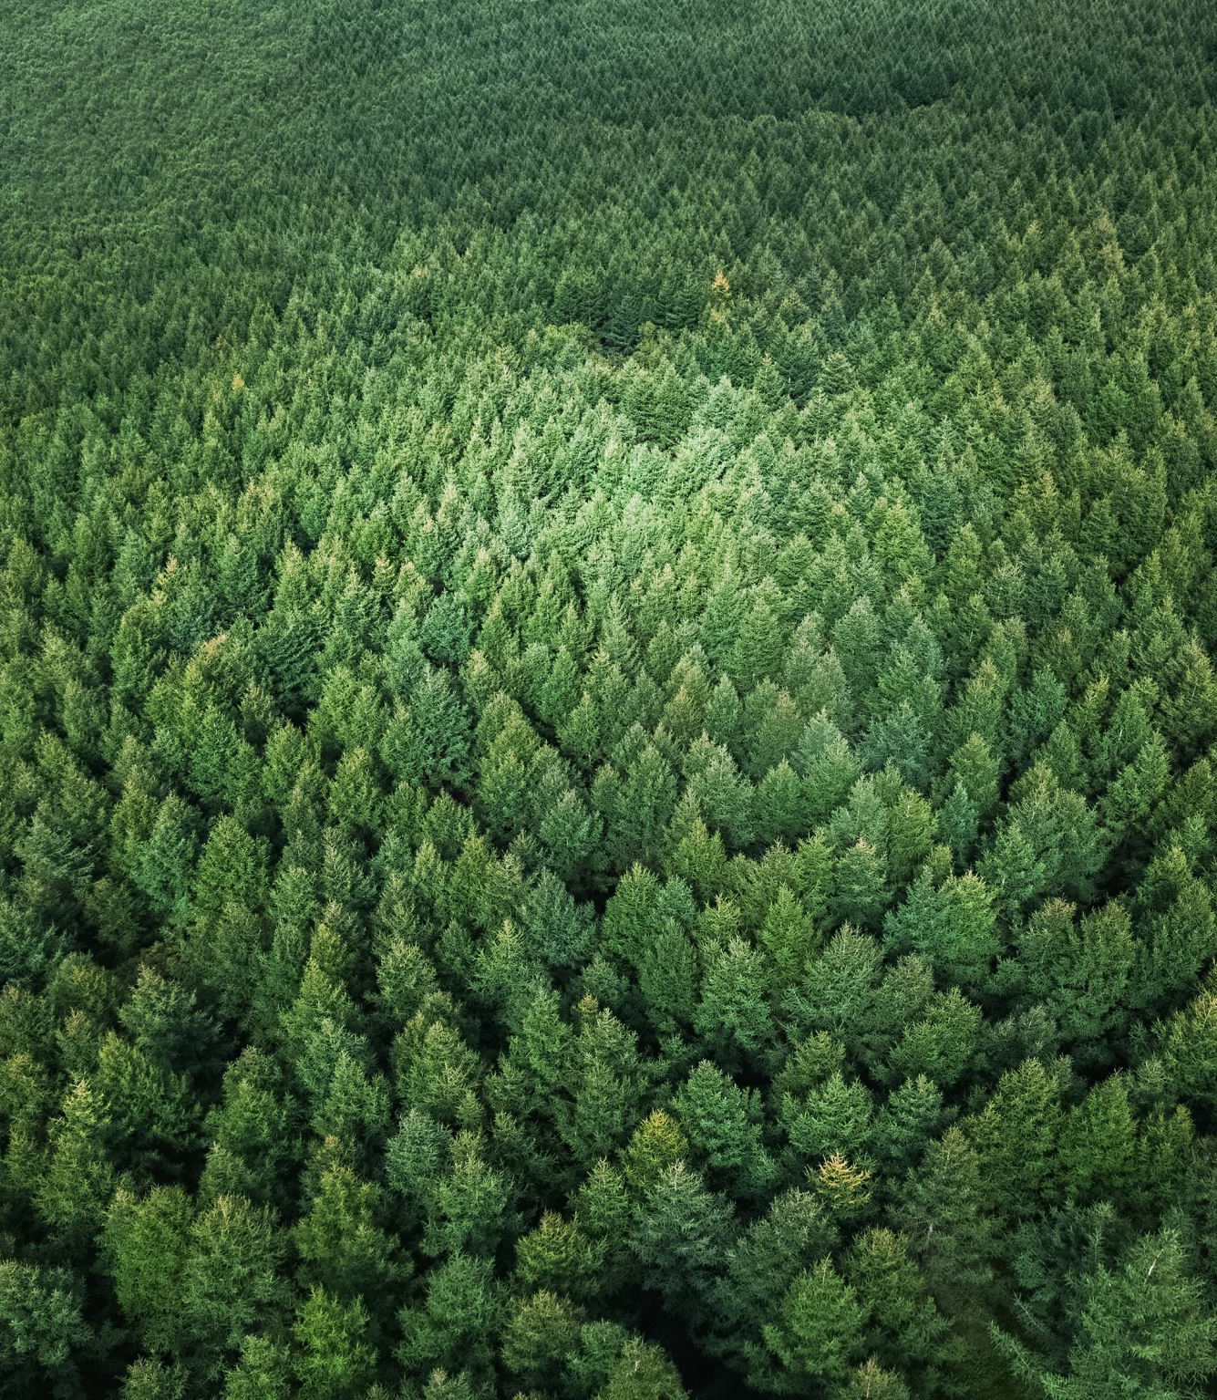
Random Forest Analysis
Measuring Accuracy – The accuracy score shows how well the model predicts conversions.
Detailed Performance Breakdown – Precision, recall, and F1-score give a full picture of model effectiveness.
Consistent Results – Setting a random state ensures we get the same results each time.
Handles Big Data Well – Random Forest works efficiently with large marketing datasets.
Balanced Accuracy for Fair Evaluation – Accounts for class imbalances, giving a more accurate measure.

Slide 23
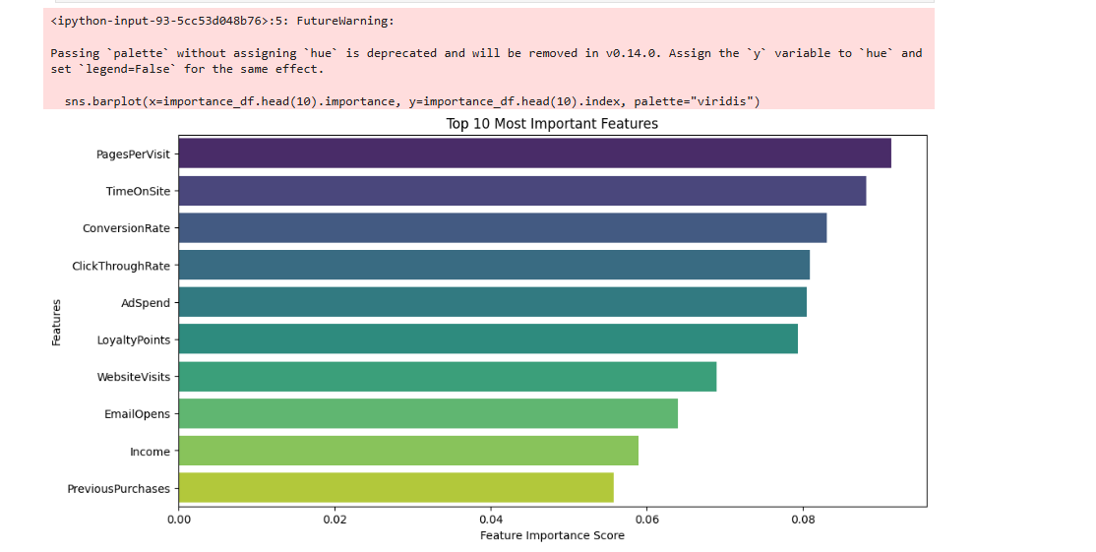
Random Forest Analysis
Outstanding 88% overall accuracy shows model's strong predictive power
Near-perfect recall (1.00) for Class 1 with only 3 false negatives out of 1,767 cases
Robust handling of imbalanced data while maintaining high precision (0.90) for both classes

Slide 24


Data Visualization
https://public.tableau.com/app/profile/aaqib.jabbar6339/viz/Project4_Team4_Tableau/Story1?publish=yes

Slide 25
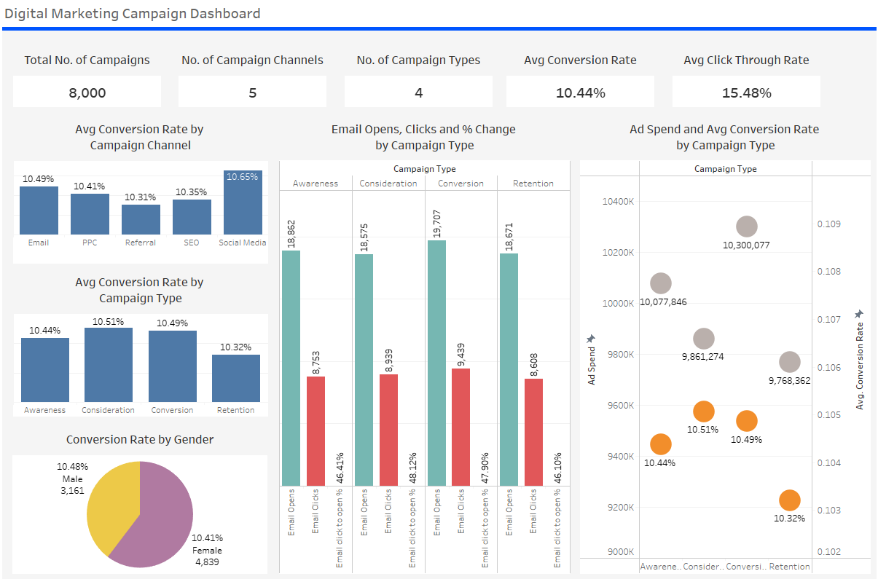
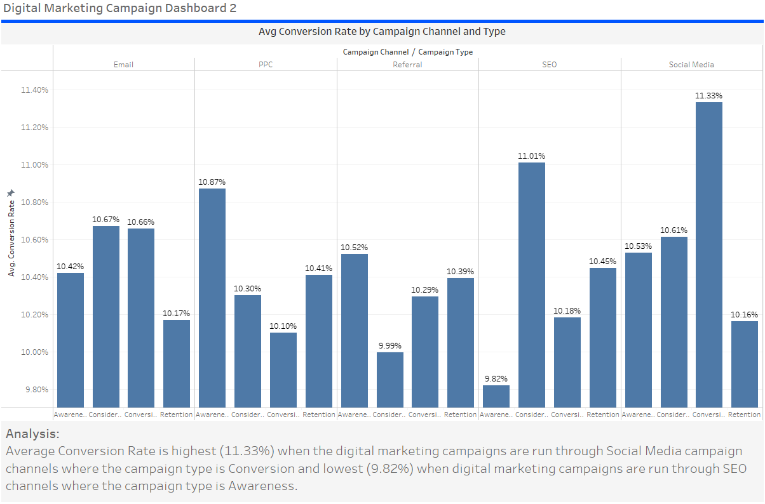
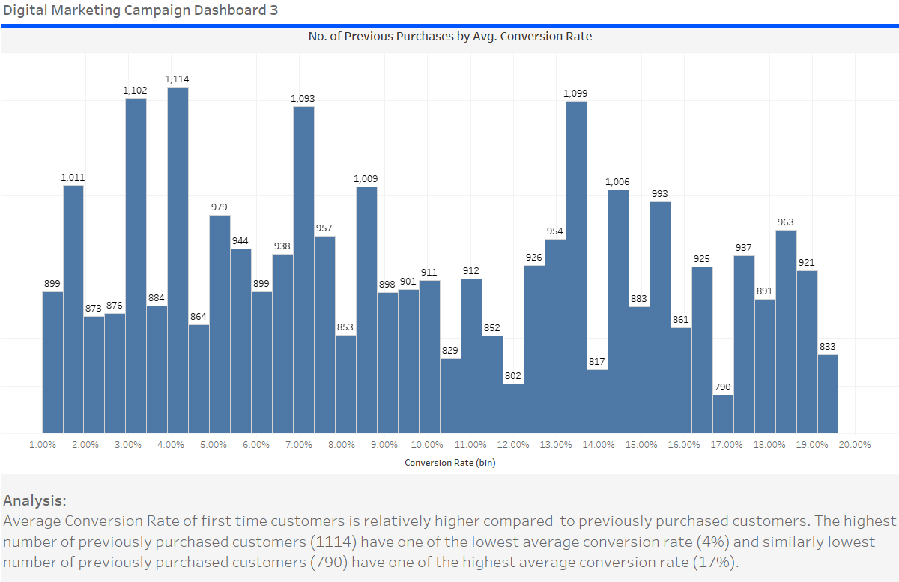
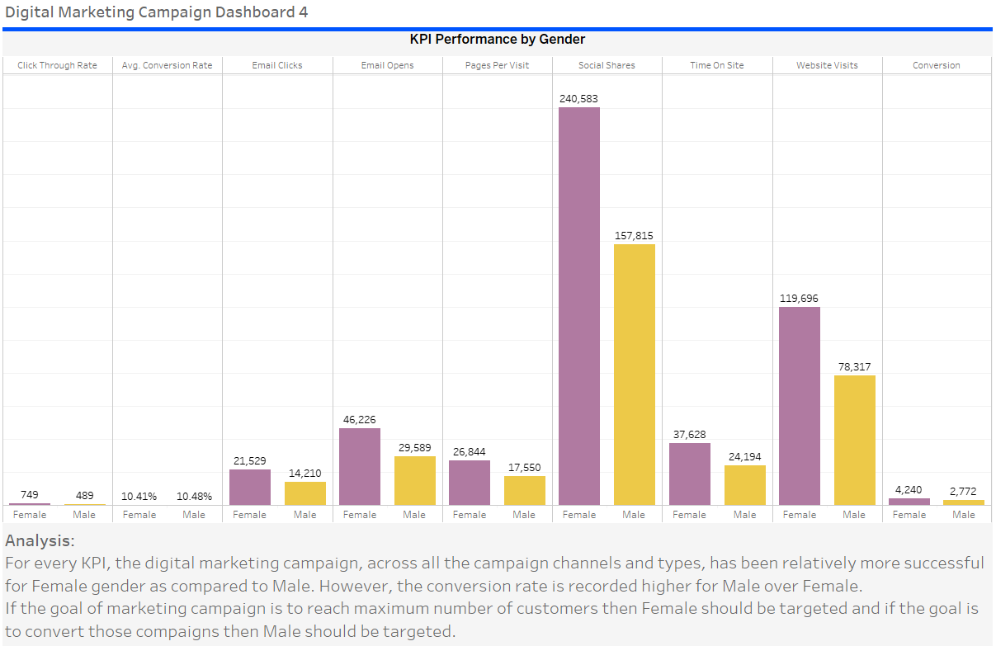
Data Visualization

Slide 26

Potential Applications
Predictive modeling of customer conversion rates.
Analyzing the effectiveness of different marketing channels and campaign types.
Identifying key factors driving customer engagement and conversion.
Optimizing ad spend and campaign strategies to improve Return on Investment (ROI).

